Slide 1






Task# 02
HOT ZONES OF TERRORISM AROUND THE GLOBE
@The Sparks Foundation
Presented by: Ans Rehman

Slide 2

Problem Overview
Perform 'Exploratory Data Analysis' on the provided dataset Global Terrorism.
As a Security/Defense Analyst, try to find out the hot zones of terrorism.
What all security issues and insights you can derive by
EDA?
GRIPJULY24 | 2024 | @The Sparks Foundation

Slide 3
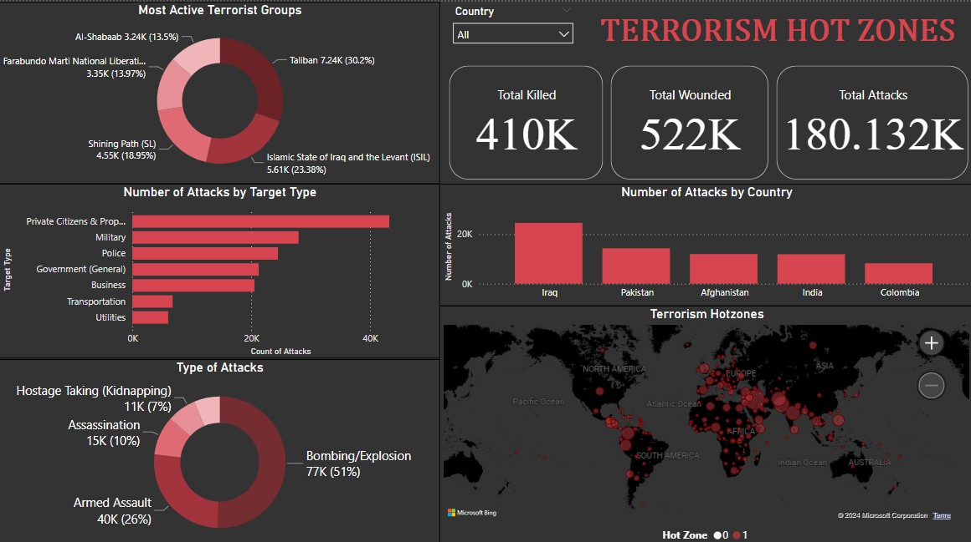

Slide 4
Key Insights on Global Terrorism Hot Zones
Most attacked places
Most active terrorist groups
Highest number of attacks year
Most common methods of attack
Primary targets
Most deadliest group
Iraq, Afghanistan, Pakistan, India, and Combodia.
Taliban, ISIL, Shining Path, and FMLN.
2014
Bombing/Explosions, armed assaults, and assassinations.
Private citizens and property; military and police.
The Taliban , responsible for 943 attacks in Afghanistan in 2015.
GRIPJULY24 | 2024 | @The Sparks Foundation

Slide 5
Thank you!
Presented by: Ans Rehman

